Slide 1
GRADUATE SCHOOL OF NATURAL&APPLIED SCIENCES Thesis Template User's Guide
It is a guide for easy use of the relevant sections in the template.
It is important for the layout of the thesis not to take any action other than what is explained in the guide.

Slide 2
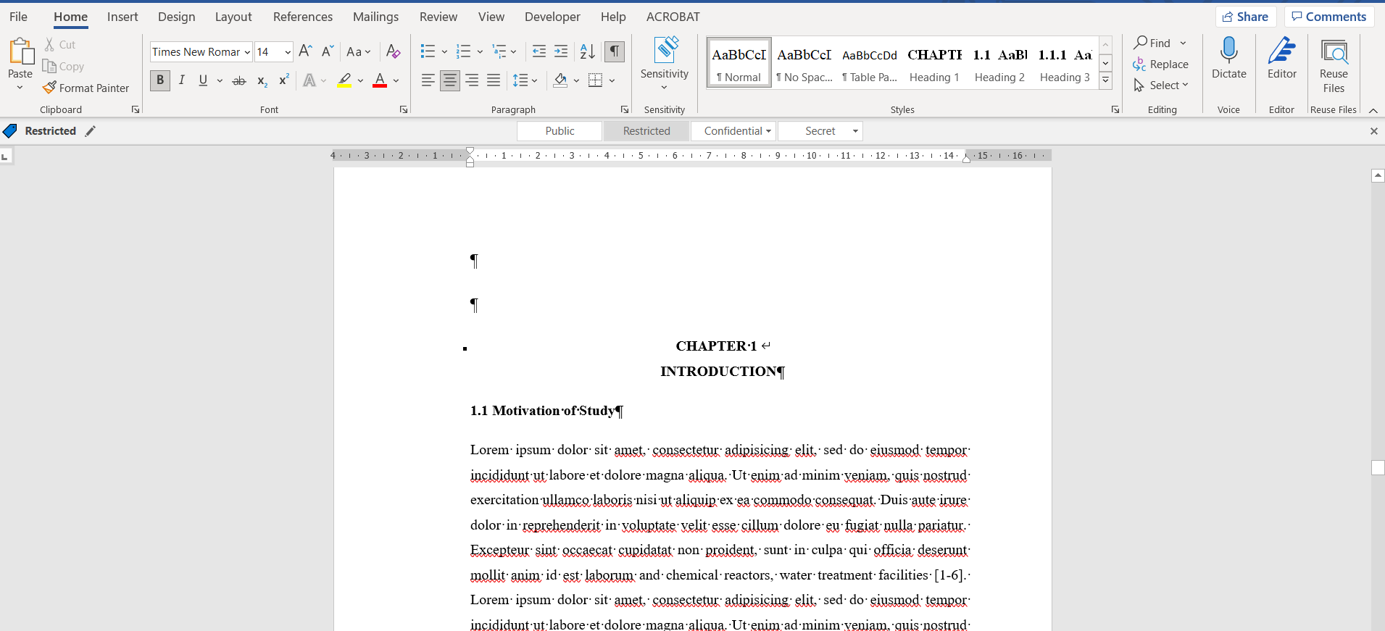
First of all, we click on the icon in the red marked section to view the spaces used in the thesis text. The spaces before the chapter titles in the main text (the green marked part) belong to the template and should never be deleted.

Slide 3
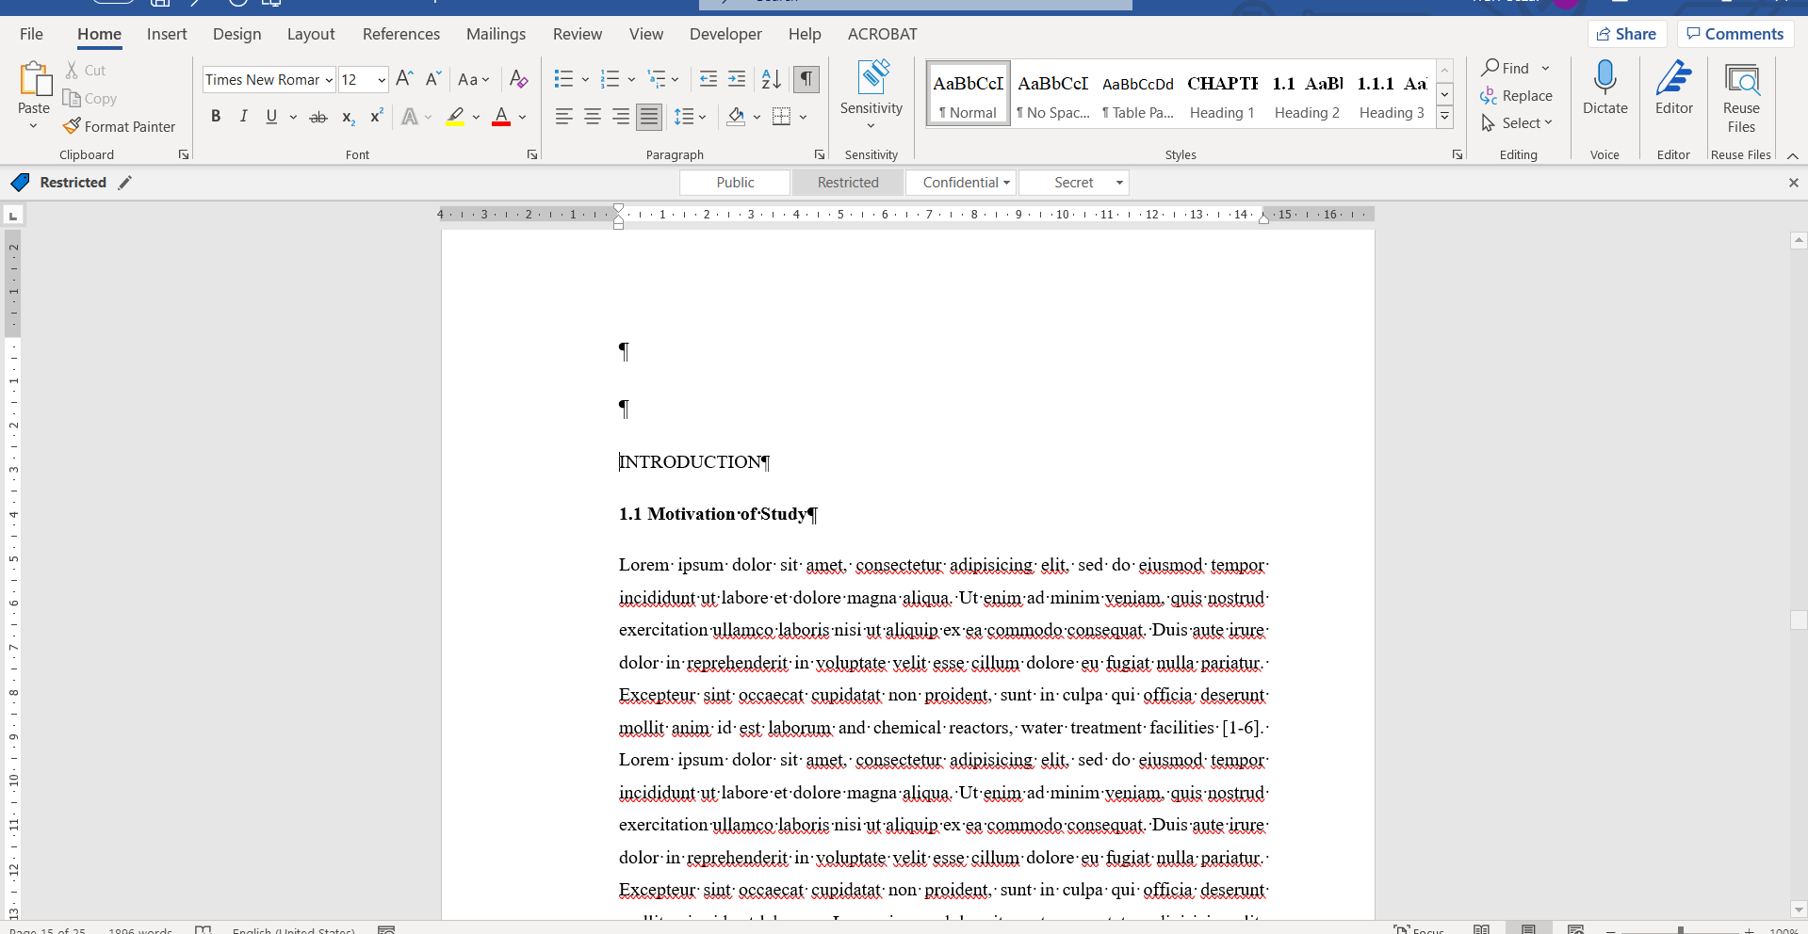
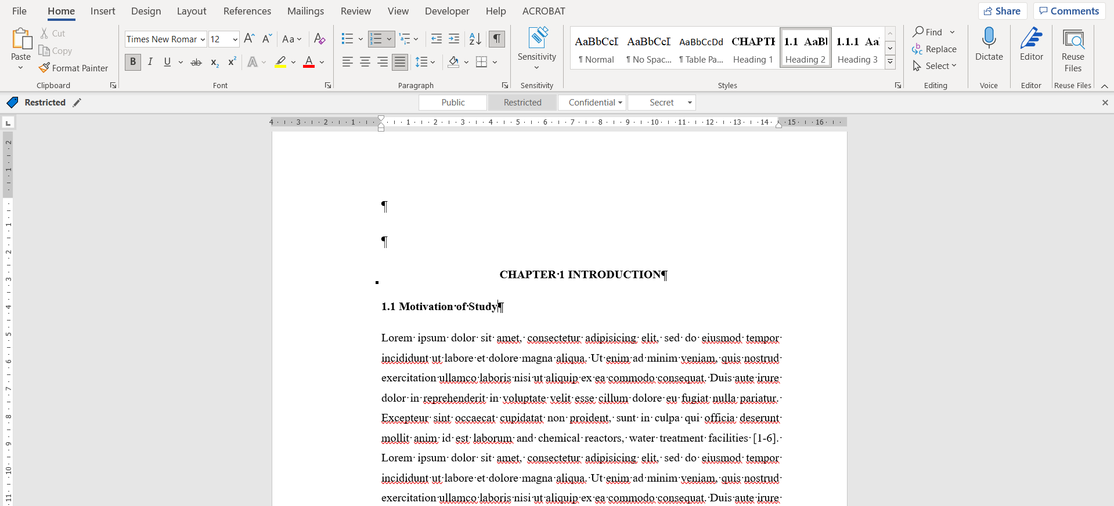
For all the titles we write, we define the title type by choosing the title type from the styles (red marked area) in the home tab, according to whether they are 1st, 2nd, 3rd level titles, so that our title becomes appropriate for the rule (Green marked field).

Slide 4
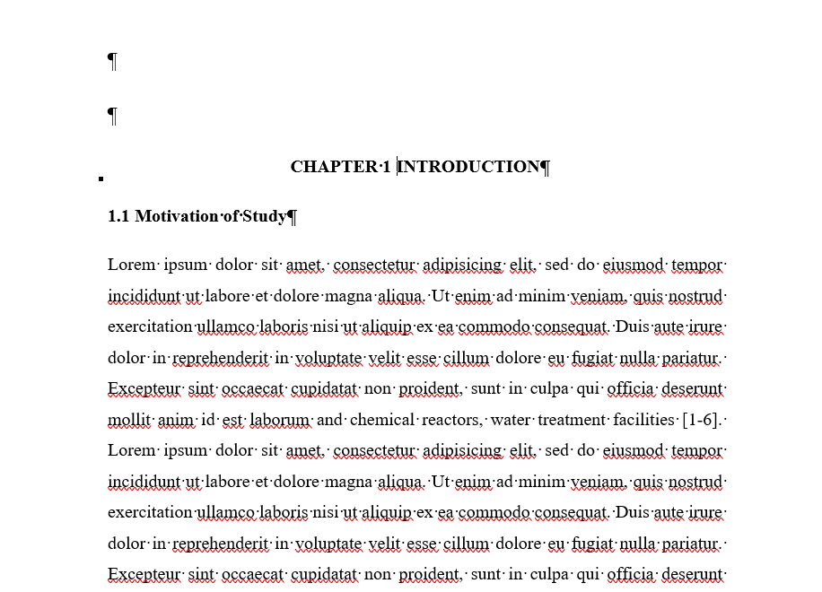
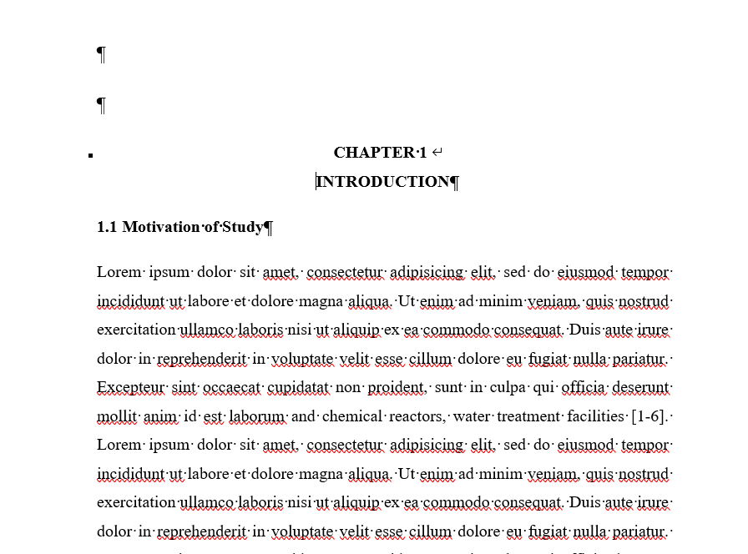
Only for the 1st level titles, we press the shift and enter keys at the same time (the green marked part) after the main chapter title (For example; Chapter 1 Introduction) and after Chapter 1 (the red marked area), so the title becomes two lines, but the style does not change. It appears as a single line in the table of contents.

Slide 5
In the current template, sections up to the 5th main heading have been defined and additions or deletions can be made when necessary. These main section titles are left ready to use with Shift+Enter.

Slide 6
When adding titles to the main sections, each word that will be written in front of the space cursor (the area indicated by the red arrow) just below the section titles available in the template will be automatically defined as the title (the green marked area).

Slide 7
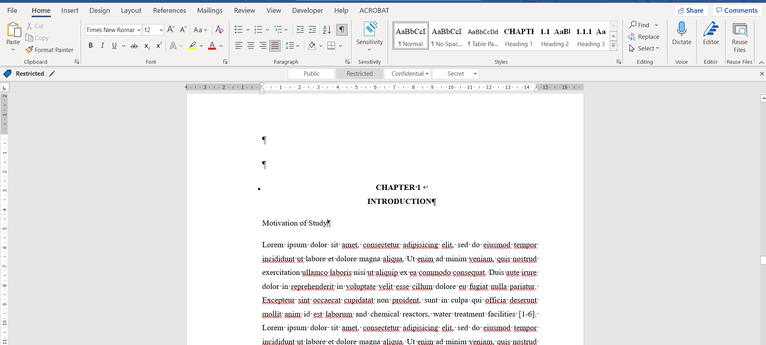
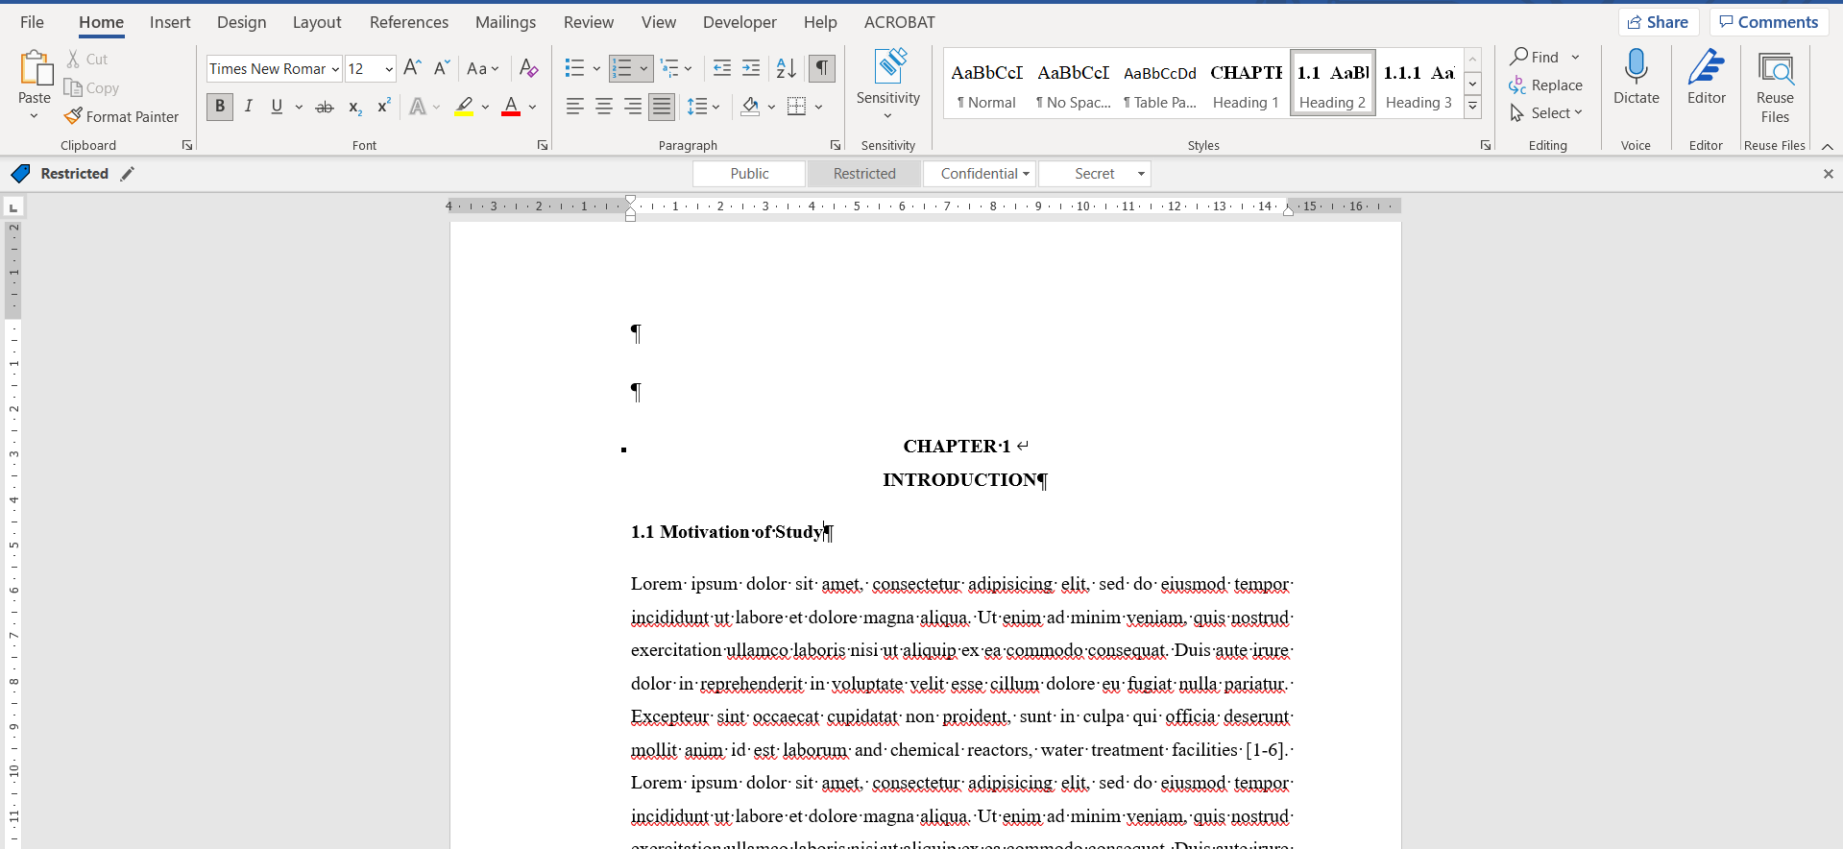
You can make numbering automatically (green marked area) by selecting the heading style (red marked area) in the lower level headings. In the current thesis template, headings up to the 7th subheading and their automatic numbering are set and ready to use.

Slide 8
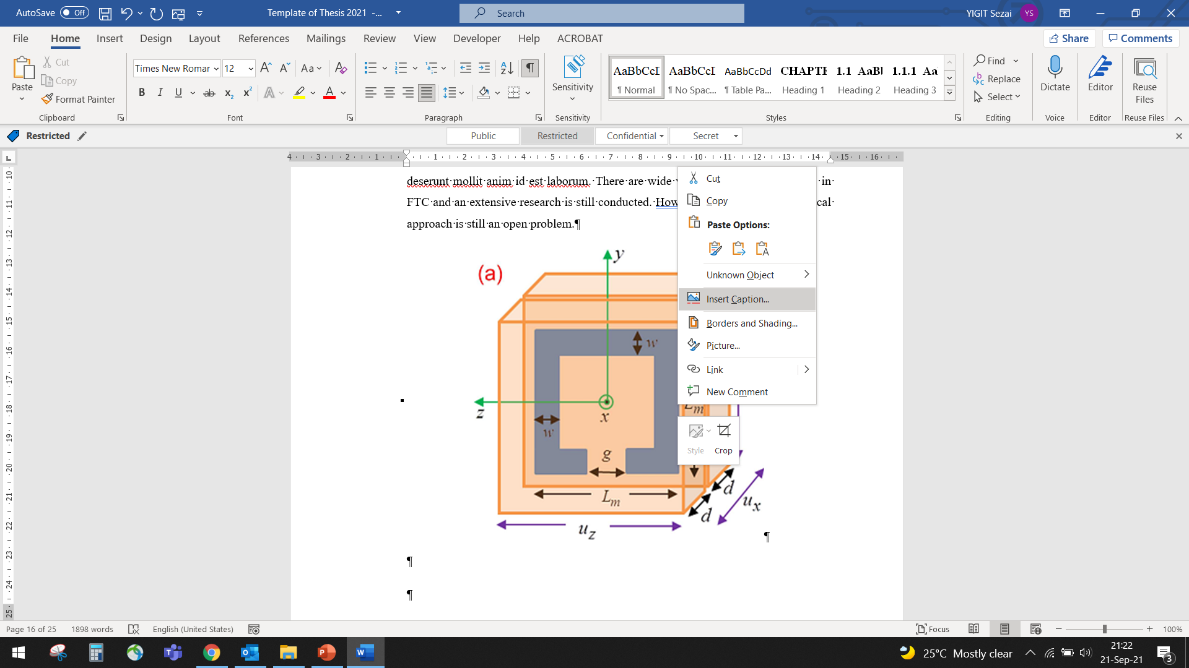
While adding a caption, right-click on the image or table and add it with the add caption option.

Slide 9
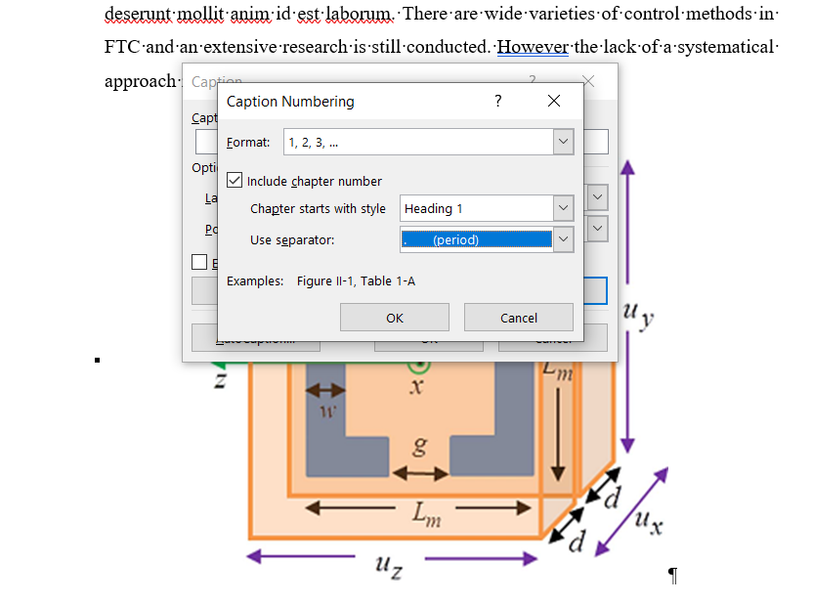
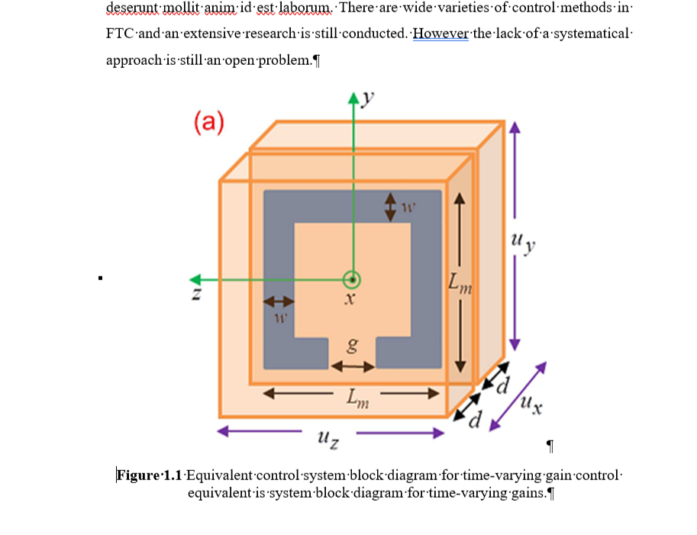
When adding the caption, we first select the label and then decide whether it should be above or below the shape. Then, by clicking on the number section, we add a section number and select a point as the separator to be used. Thus, all shapes are automatically numbered. We write our shape description after the number.
2
1
3

Slide 10
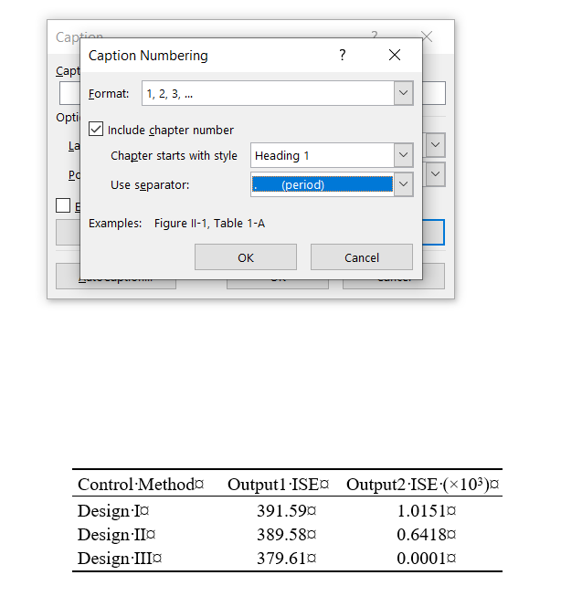
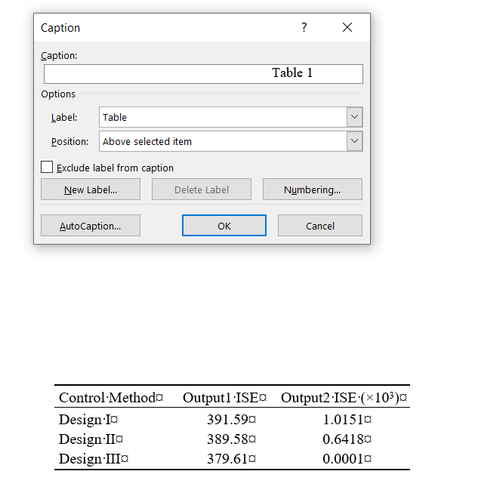
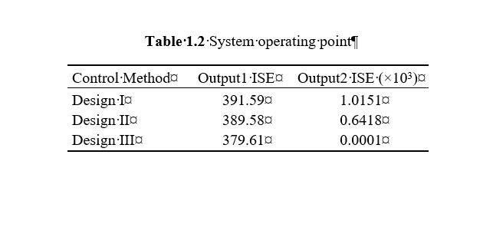
We use the same method when naming the tables.
3
1
4
2

Slide 11
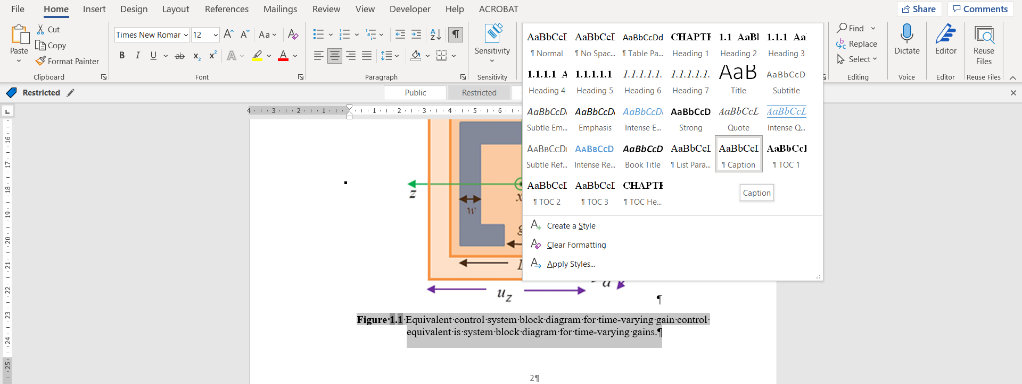
When editing Figure and Table names, if you select the Caption option from the Styles section, it will automatically set the relevant spaces correctly.

Slide 12
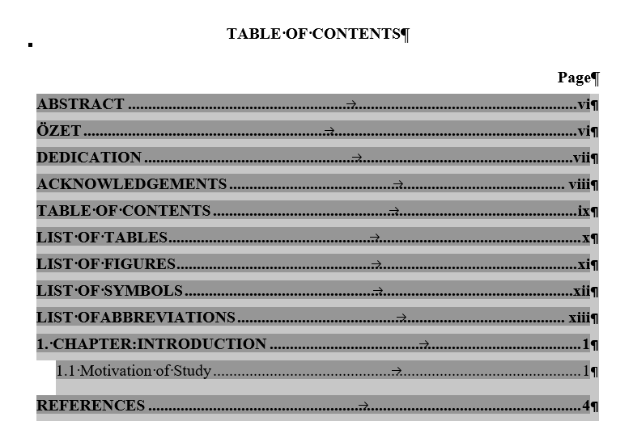
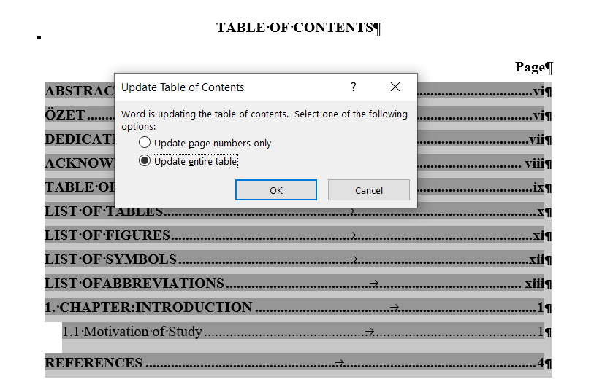
If we have made all these definitions correctly, we come to the table of contents and right-click on the table by marking it. We tick the options Update field and Update entire table and the table of contents is created automatically.
1
2
3

Slide 13
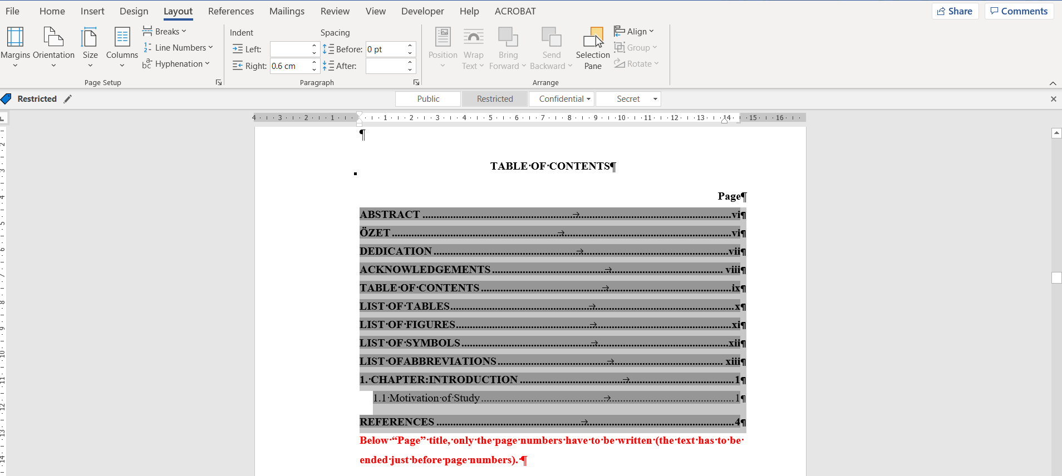
After creating content lists, we mark the list. By clicking the layout tab at the top, we set the right indent to 0.6. Thus, there is no text under the page numbers.

Slide 14
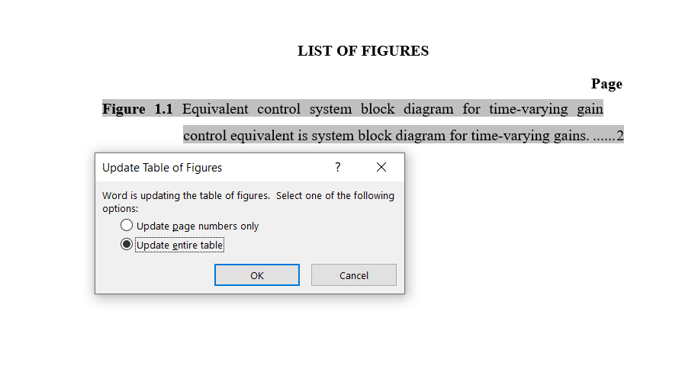
While creating the lists of figures and tables, we automatically create the list of figures by coming to the list of figures in the thesis template and checking the options update the field, update the whole table, as in the table of contents.
1
1
2
2

Slide 15
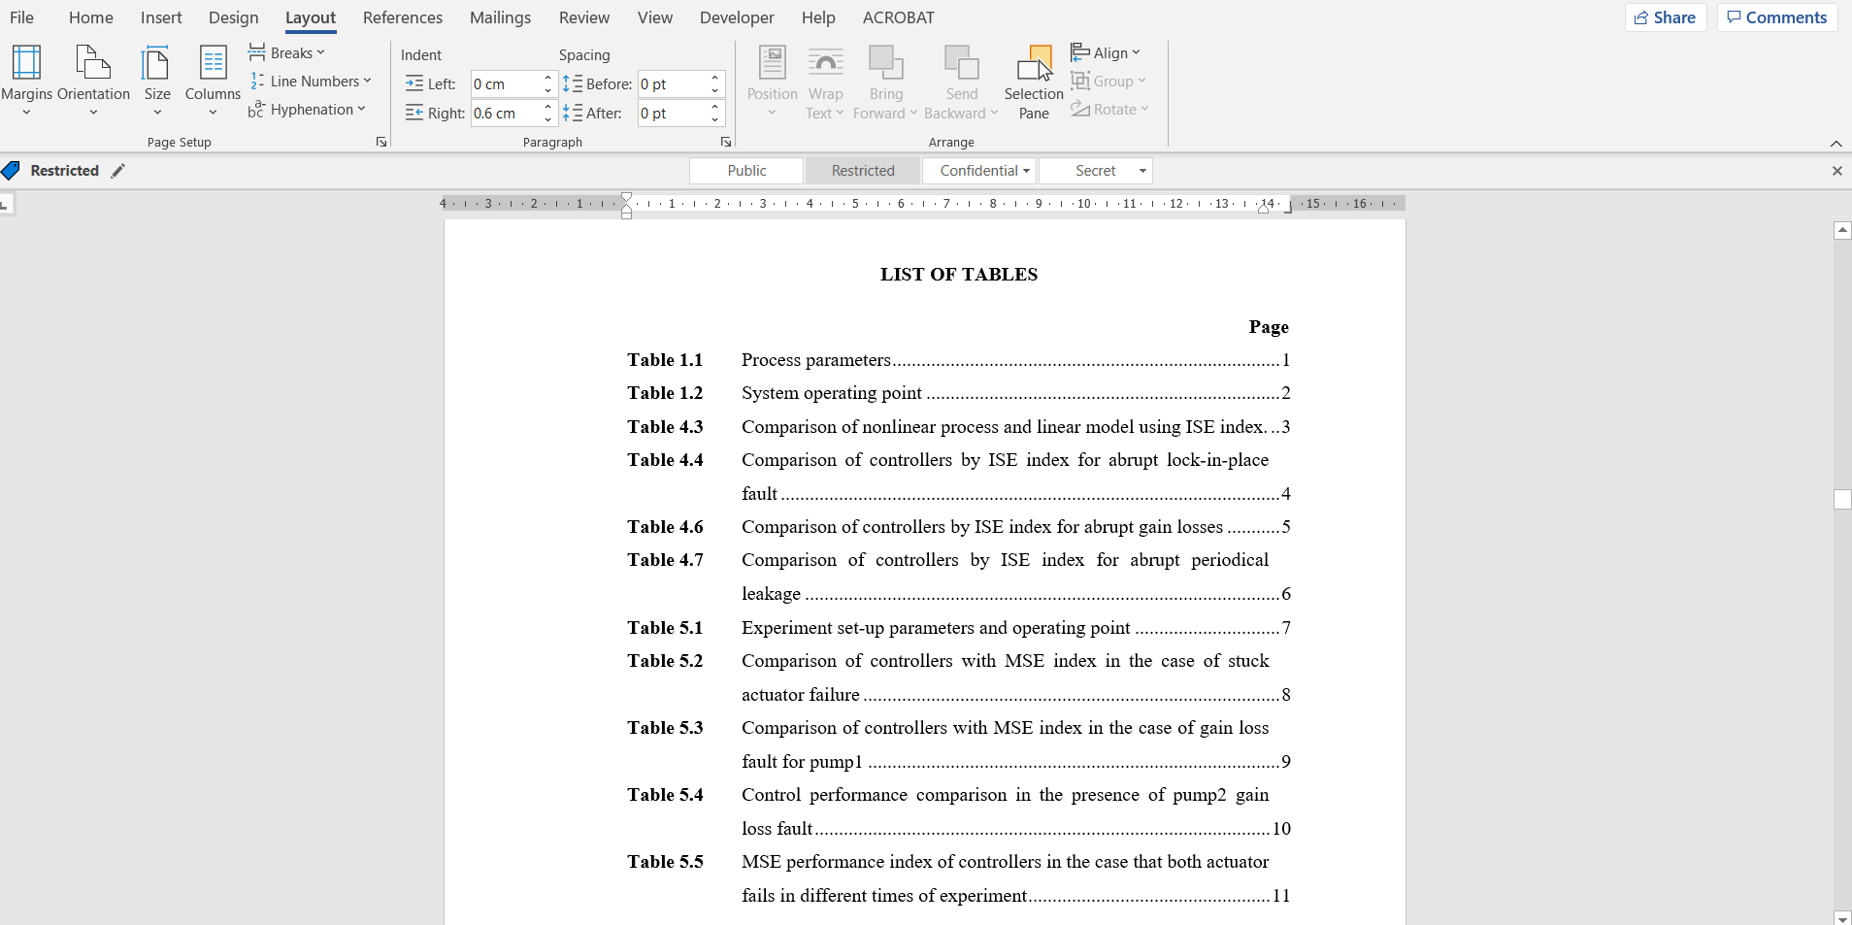
After creating the figure and table lists, we mark the list. By clicking the layout tab at the top, we set the right indent to 0.6. Thus, there is no text under the page numbers.

Slide 16
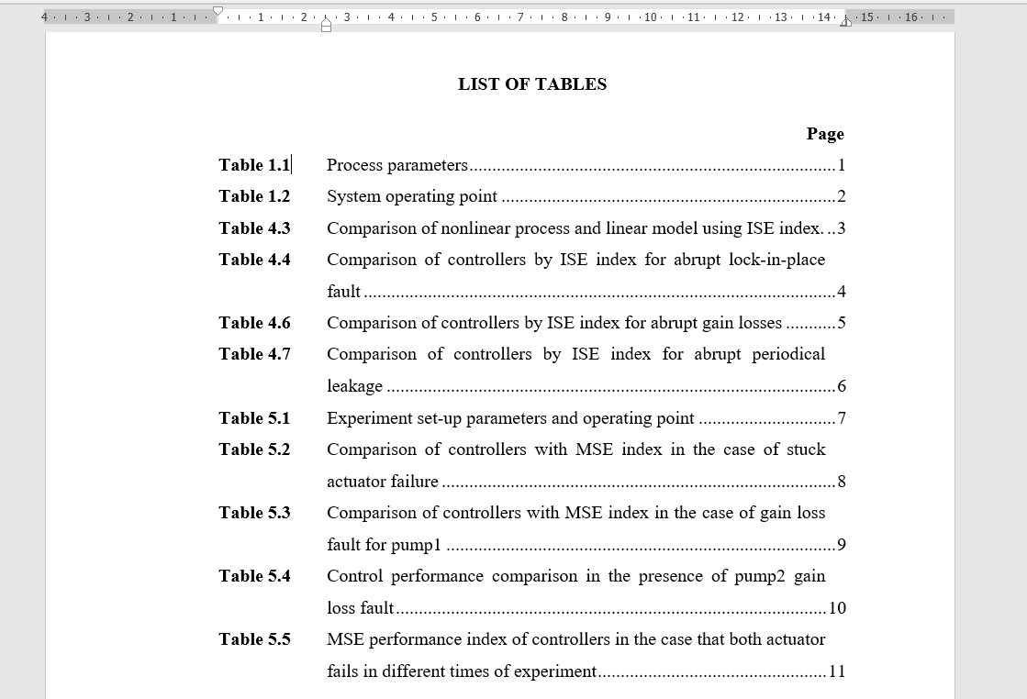
Then again, by marking the entire list of figures and tables, we pull the lower tail of the cursor on the ruler (the cursor in the red circle) to the right and bring it to the end of the figure number. Thus, there is no text under the Figure and Table numbers. (Creating the indentation indicated by the arrow).

